Slide 1
Name : Nallagondu sreenuvasulunaidu
NM ID : au713921106030
Email : sreenu1713257@gmail.com
College code:7139
Innovation in Smart Water System using IoT

Slide 2
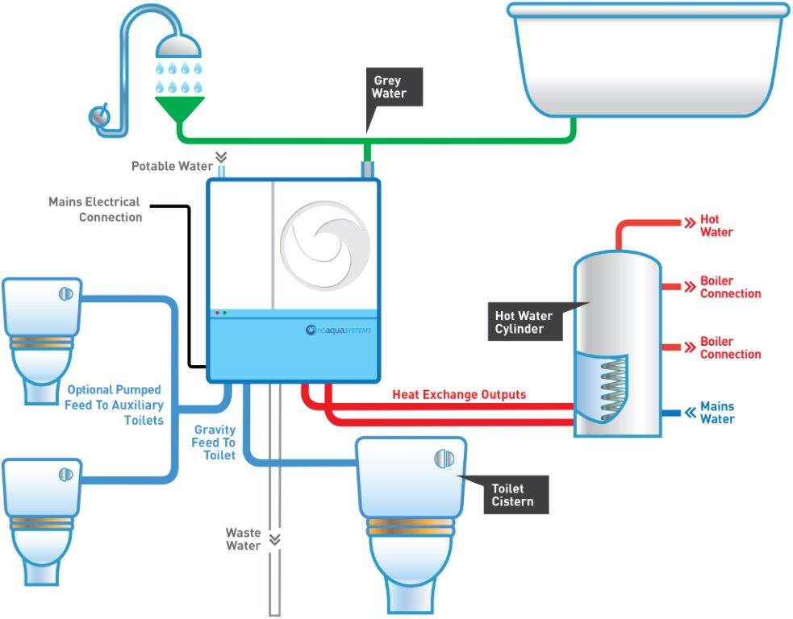
Introduction to Smart Water Systems
Smart water systems use advanced technologies to monitor and manage water resources efficiently.
These systems aim to address challenges such as water scarcity, aging infrastructure, and water quality issues.
By leveraging real-time data and automation, smart water systems enable better decision-making and optimize water usage.

Slide 3
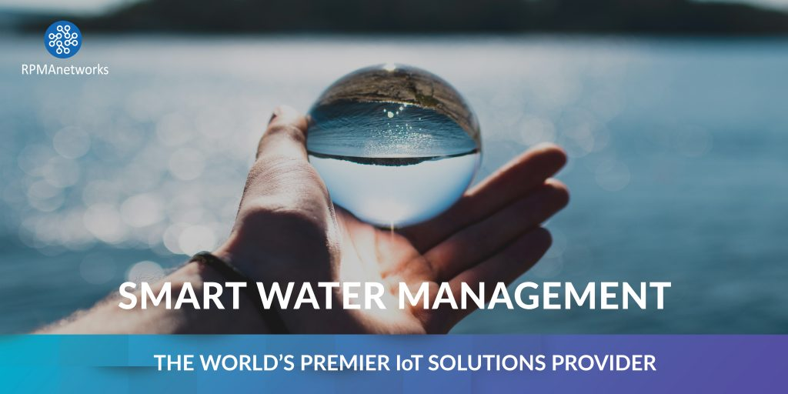

Slide 4
Real-Time Monitoring and Detection
Smart water systems continuously monitor water infrastructure and detect abnormalities such as leaks, bursts, or pressure variations.
Sensors can also identify changes in water quality parameters, alerting authorities to potential contamination issues.
Real-time monitoring ensures prompt response and efficient resource allocation for maintenance and repairs.

Slide 5
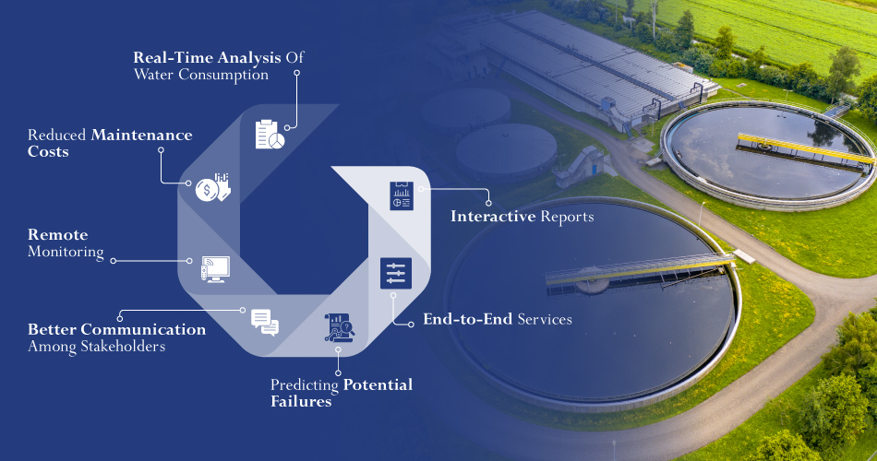
Benefits of Smart Water Systems
Improved water conservation: Smart water systems help detect leaks and reduce water wastage, leading to significant water savings.

Slide 6
Predictive Analytics and Decision-Making
Data analytics algorithms analyze historical and real-time data to identify trends, patterns, and anomalies.
Predictive models help anticipate water demand, optimize water distribution, and plan infrastructure upgrades.
Data-driven decision-making enables water utilities to allocate resources efficiently and respond proactively to changing conditions.

Slide 7
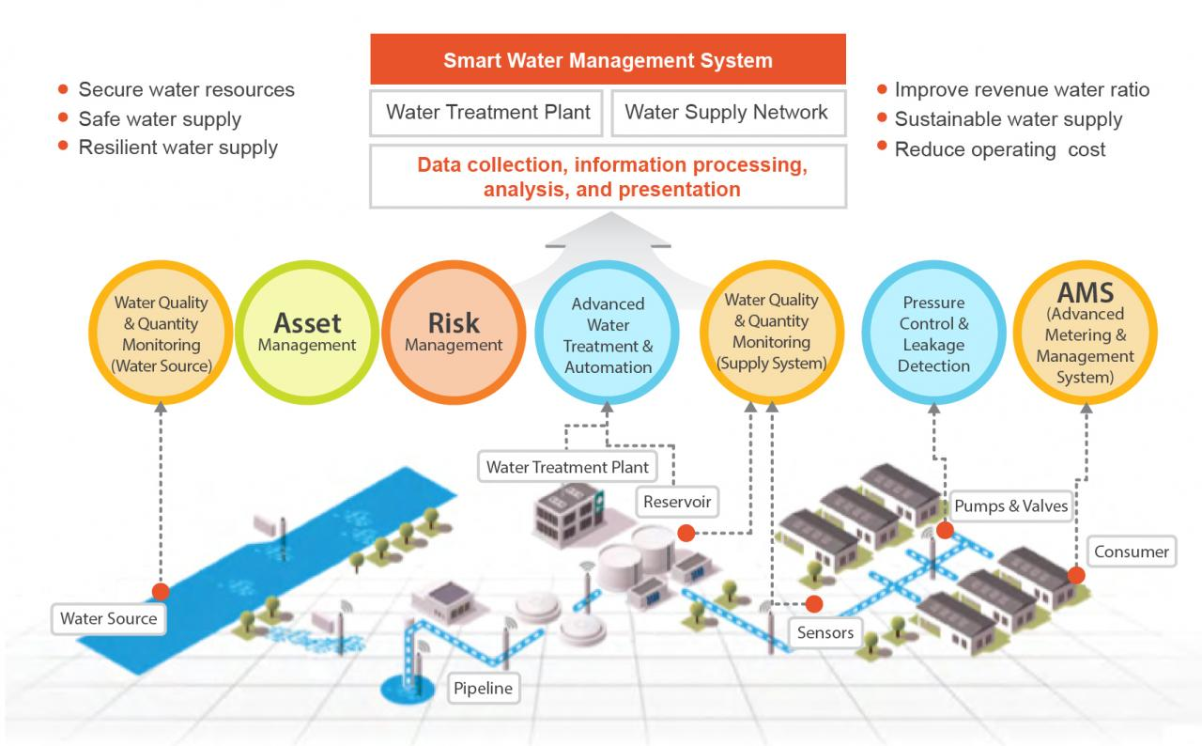
Smart Irrigation Systems
Smart water systems can integrate with irrigation systems to optimize watering schedules based on weather conditions and soil moisture levels.
Sensors measure soil moisture, temperature, and humidity to ensure precise and efficient irrigation, reducing water waste.
Automated controls and remote monitoring enable farmers and landscape managers to remotely manage irrigation systems.

Slide 8
Challenges and Considerations
Data Security: Smart water systems must ensure the protection of sensitive data and secure communication networks.
Cost: Implementation costs may pose a challenge, but long-term operational savings and improved efficiency offset initial investments.
Adoption and Integration: Transitioning to smart water systems requires collaboration among utilities, municipalities, and technology providers.

Slide 9
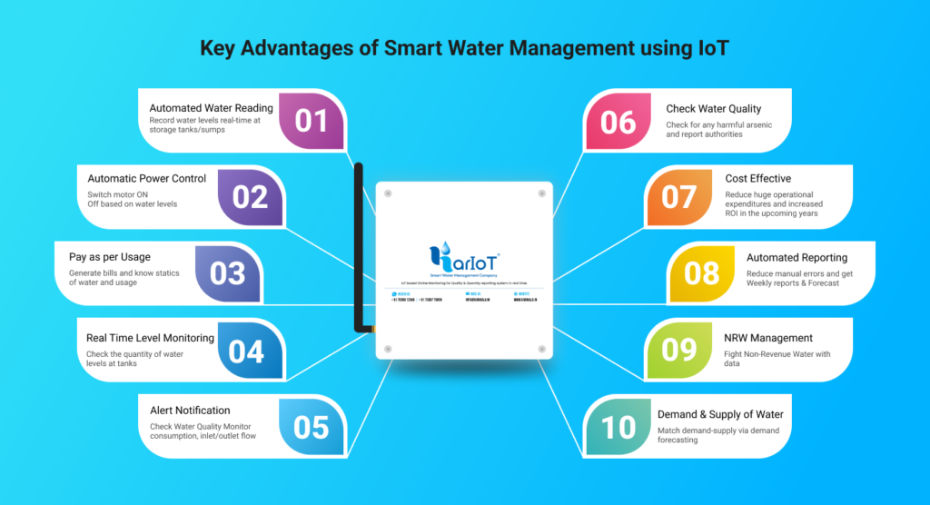
Water Conservation and Demand Management
Smart water systems provide detailed insights into water usage patterns, enabling consumers to track and optimize their consumption.
Automated metering and billing systems enable accurate billing based on actual usage, incentivizing water conservation.
Demand management strategies, such as dynamic pricing and water usage alerts, encourage responsible water usage.

Slide 10
Case Study: Singapore's Smart Water Grid
Singapore implemented a comprehensive smart water grid to address water scarcity challenges.
Real-time monitoring, leak detection, and pressure management systems resulted in a 23% reduction in water loss.
Smart metering and customer engagement programs led to a 7% reduction in domestic water consumption.

Slide 11
Conclusion
Smart water systems offer a transformative solution to manage water resources effectively and sustainably.
By leveraging advanced technologies and data analytics, these systems enable water conservation, infrastructure optimization, and improved water quality.
Widespread adoption of smart water systems can drive significant environmental and economic benefits for communities worldwide.

